Slide 1
Predicting Members for
Taraqur Rahman

Slide 2
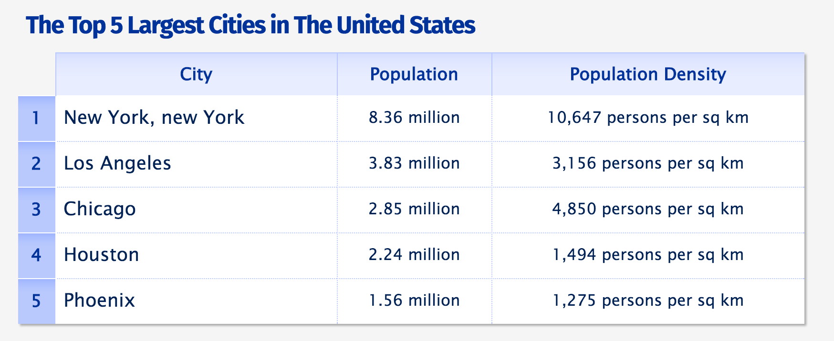
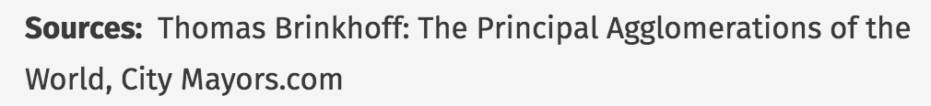
Data Data Data
Meetup API
Five cities

Slide 3
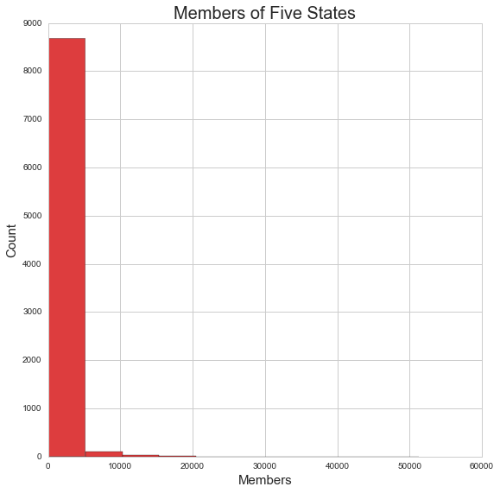

Slide 4
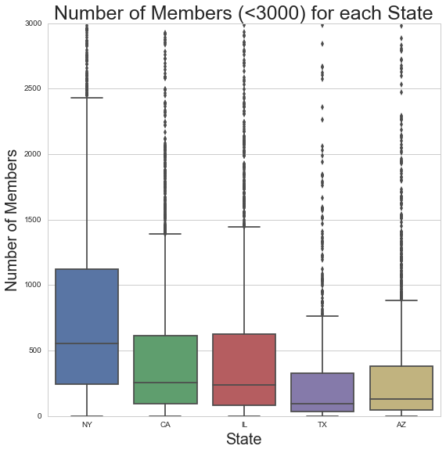

Slide 5
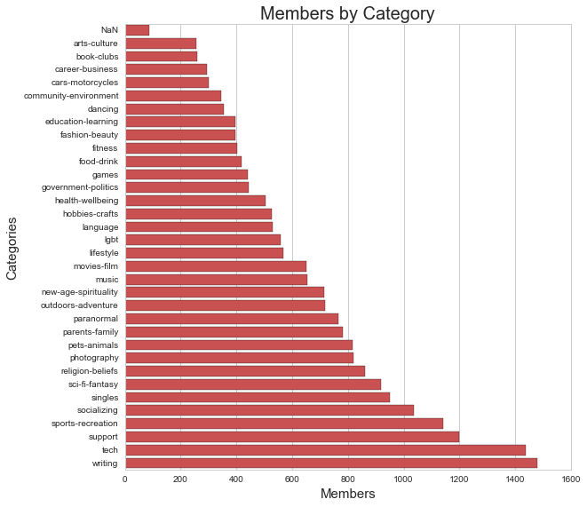

Slide 6
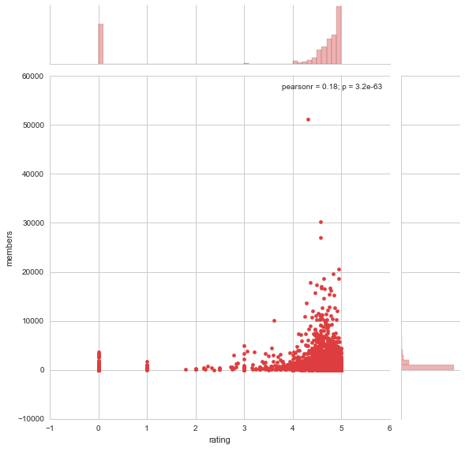

Slide 7
Missingness
Categories
8 NaN
Randomly imputed categories
Ratings
Mean Imputation

Slide 8
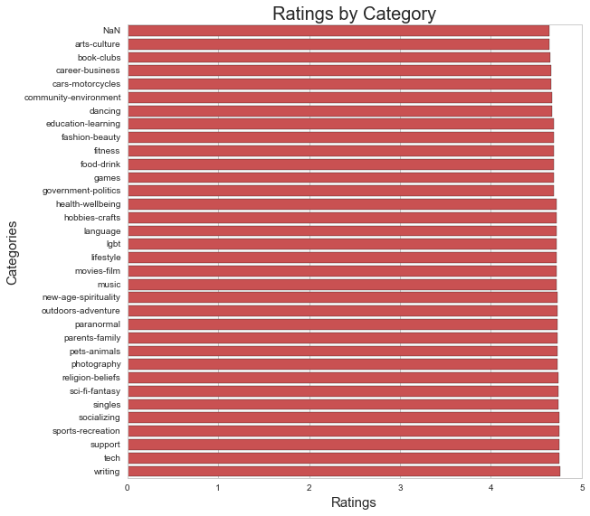

Slide 9
Random Forest
GridSearch
n_estimators : 10, 50, 100
min_samples_leaf: 1-5
min_samples_split: 2-30 counting by 2’s
cv = 5
Best parameters
n_estimators : 50
min_samples_leaf: 4
min_samples_split: 24

Slide 10
Results
training accuracy : 0.86
test accuracy : 0.59

Slide 11
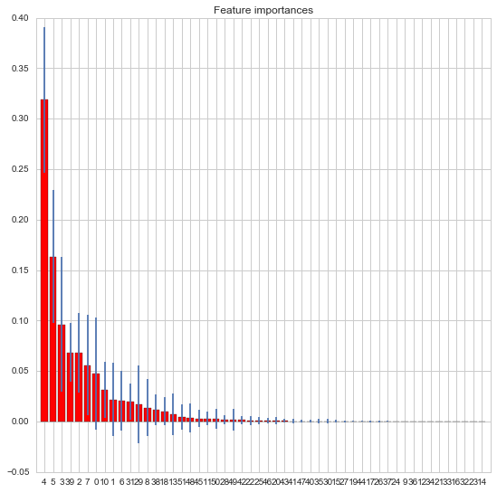

Slide 12
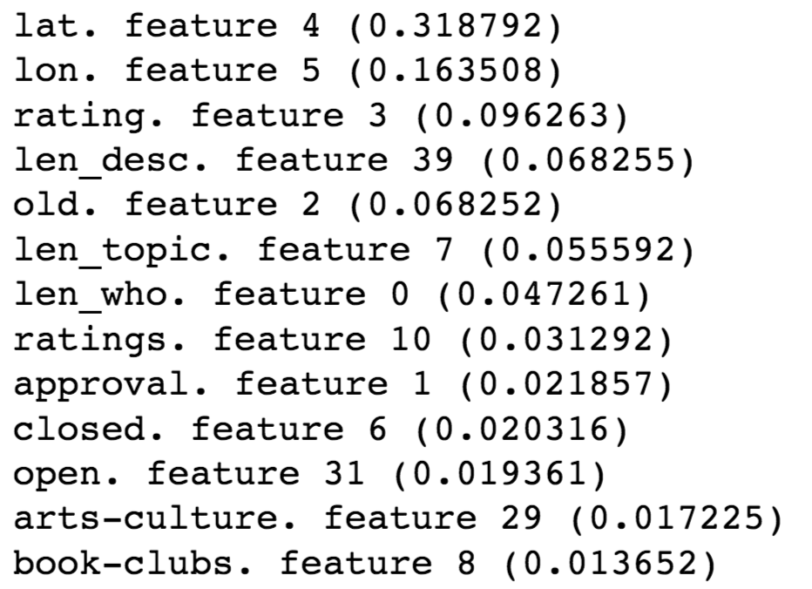
Feature Importance

Slide 13
Conclusion
Needed more Data! Data! Data!
More features
More states
Use word2vec to convert words to vector
Dumify the topics
Try more machine learning models

